Slide 1
Thevenin’s and Norton Theorem EEE Lecture-13

Slide 2
9.3 Thevenin’s Theorems
Thévenin’s theorem, is probably one of the most interesting in that it permits the reduction of complex networks to a simpler form for analysis and design.
In general, the theorem can be used to do the following:
Analyze networks with sources that are not in series or parallel.
Reduce the number of components required to establish the same characteristics at the output terminals.
Investigate the effect of changing a particular component on the behavior of a network without having to analyze the entire network after each change.

Slide 3
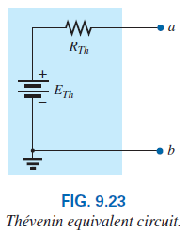
9.3 Thevenin’s Theorems
Thévenin’s theorem states the following:
Any two-terminal, linear bilateral dc network can be replaced by an equivalent circuit consisting of a voltage source and a series resistor.

Slide 4
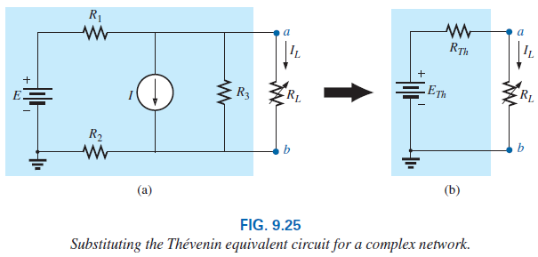
9.3 Thevenin’s Theorems
To demonstrate the power of the theorem, consider the network of Fig. 9.25(a) with its two sources and series-parallel connections.
The theorem states that the entire network inside the blue shaded area can be replaced by one voltage source and one resistor as shown in Fig. 9.25(b).

Slide 5
9.3 Thevenin’s Theorems
If the replacement is done properly, the voltage across, and the current through, the resistor R_{L} will be the same for each network.
The value of R_{L} can be changed to any value, and the voltage, current, or power to the load resistor is the same for each configuration.
the Thévenin equivalent circuit provides an equivalence at the terminals only.

Slide 6
9.3 Thevenin’s Theorems
This theorem achieves two important objectives.
First, it allows us to find any particular voltage or current in a linear network with one, two, or any other number of sources.
Second, we can concentrate on a specific network portion by replacing the remaining network with an equivalent circuit.

Slide 7
9.3 Thevenin’s Theorem Procedure
The following sequence of steps will lead to the proper value of R_{Th} and E_{Th}.
Preliminary:
Step 1: Remove that portion of the network across which the Thévenin equivalent circuit is to be found. In Fig. 9.25(a), this requires that the load resistor R_{L} be temporarily removed from the network.
Step 2: Mark the terminals of the remaining two-terminal network.

Slide 8
9.3 Thevenin’s Theorems
R_{Th}:
Step 3: Calculate R_{Th} by first setting all sources to zero (voltage sources are replaced by short circuits and current sources by open circuits) and then finding the resultant resistance between the two marked terminals. (If the internal resistance of the voltage and/or current sources is included in the original network, it must remain when the sources are set to zero.)
E_{Th}:
Step 4: Calculate E_{Th} by first returning one source at a time to their original position and finding the open-circuit voltage between the marked terminals. If multiple sources exist, apply the superposition theorem to consider the effects of each source.

Slide 9
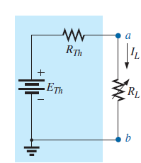
9.3 Thevenin’s Theorems
Conclusion:
Step 5: Draw the Thévenin equivalent circuit with the portion of the circuit previously removed replaced between the terminals of the equivalent circuit. This step is indicated by the placement of the resistor R_{L} between the terminals of the Thévenin equivalent circuit as shown in Fig. 9.25(b).

Slide 10
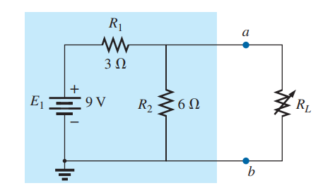
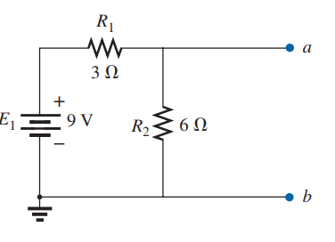
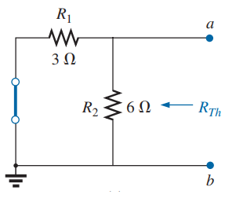

Calculating R_{th}:

Slide 11
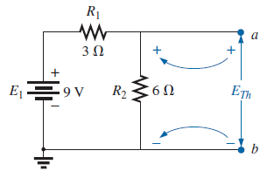
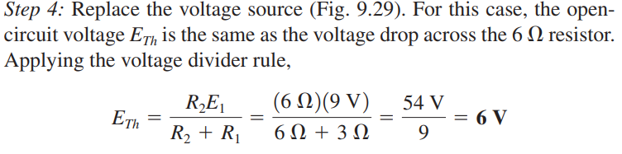
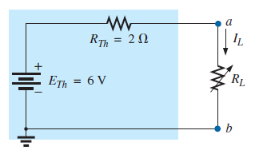
Calculating E_{th}:

Slide 12
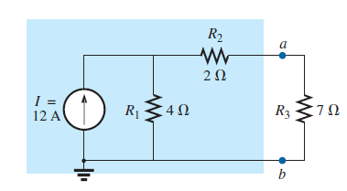
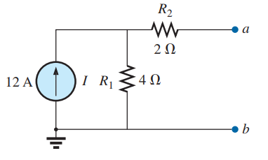
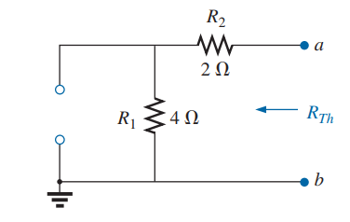
Calculating R_{th}:

Slide 13
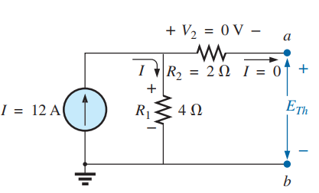
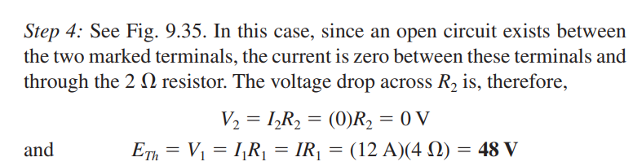
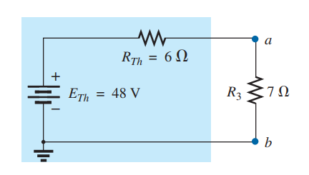
Calculating E_{th}:

Slide 14
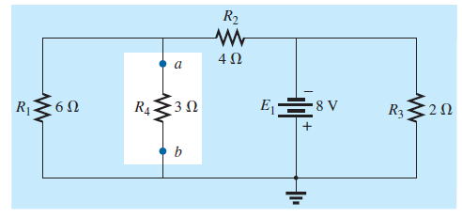
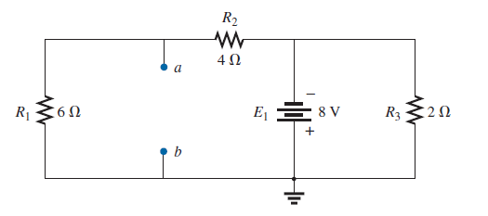
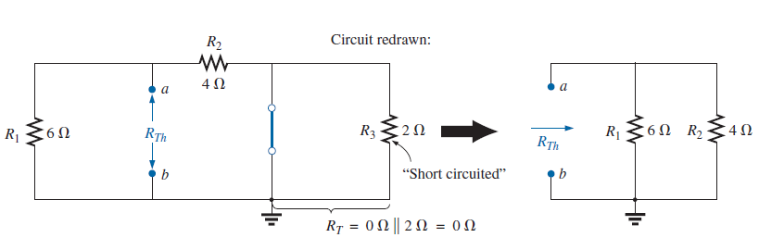

Calculating R_{th}:

Slide 15
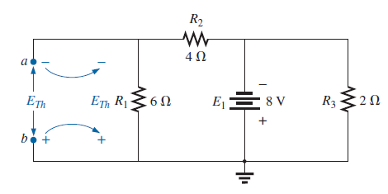
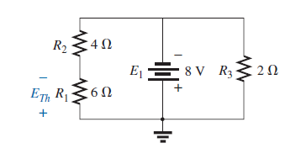
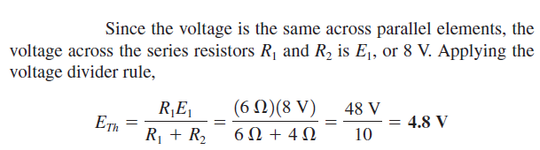
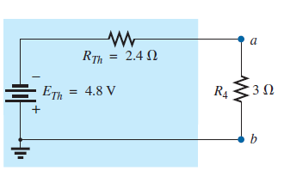

Slide 16
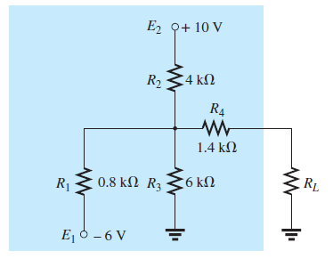
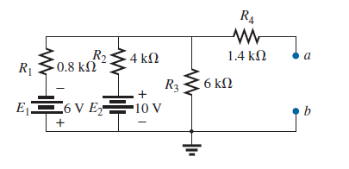
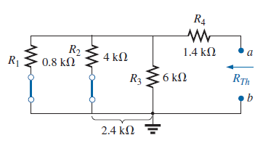
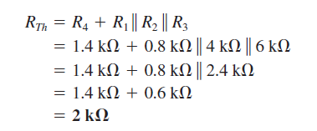
Calculating R_{th}:

Slide 17
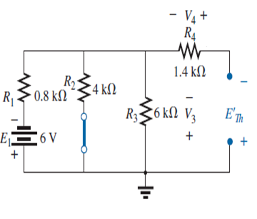
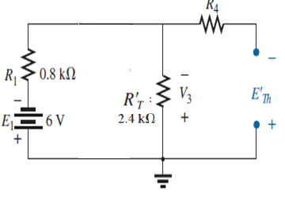
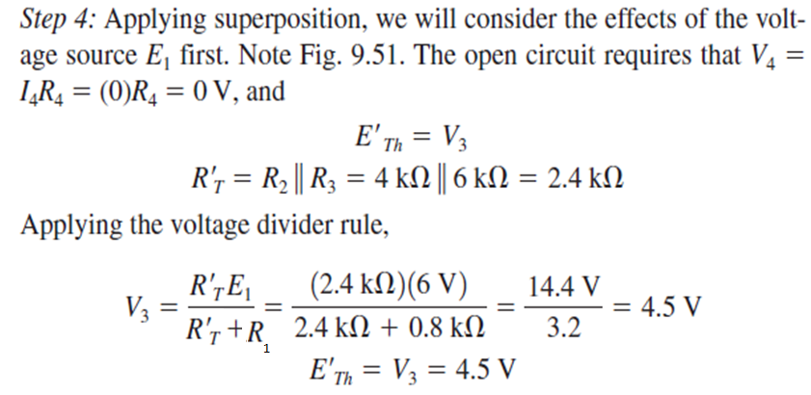

Slide 18
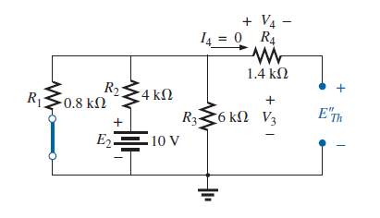
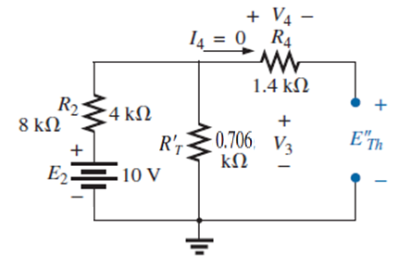
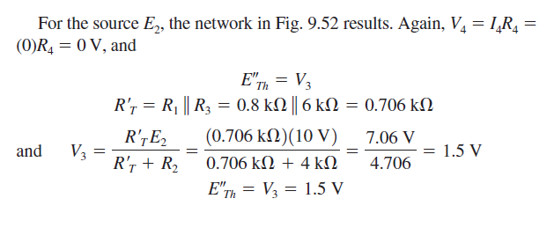

Slide 19
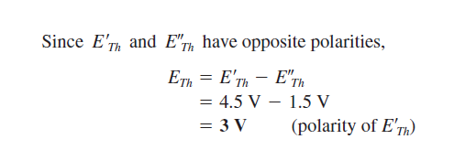
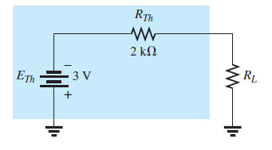

Slide 20
Advantages and Disadvantages
Advantages:
Thevinians theorem useful to analyze the large distributed networks by making it into a voltage source in series with internal resistance.
It reduce complex circuit to a simple circuit which consists of only one single source with a series with a single resistance.
Disadvantages:
Disadvantage is it is applicable only for linear and bilateral networks. For nonlinear and unilateral networks this theorem not applicable.

Slide 21
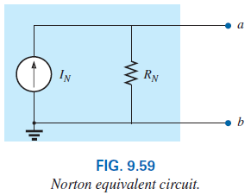
9.4 Norton’s Theorem
Every voltage source with a series internal resistance has a current source equivalent with a parallel resistor.
The Norton’s theorem states the following:
“Any two-terminal linear bilateral dc network can be replaced by an equivalent circuit consisting of a current source and a parallel resistor.”

Slide 22
9.4 Norton’s Theorem Procedure
The steps leading to the proper values of I_{N} and R_{N} are:
Preliminary:
1. Remove that portion of the network across which the Norton equivalent circuit is found.
2. Mark the terminals of the remaining two-terminal network.
R_{N}:
3. Calculate R_{N} by first setting all sources to zero (voltage sources are replaced with short circuits, and current sources with open circuits) and then finding the resultant resistance between the two marked terminals. (If the internal resistance of the voltage and/or current sources is included in the original network, it must remain when the sources are set to zero.)
Since R_{N} = R_{Th}, the procedure and value obtained using the approach described for Thévenin’s theorem will determine the same value for R_{N}.

Slide 23
9.4 Norton’s Theorem
I_{N}:
4. Calculate I_{N} by first returning all sources to their original position and then finding the short-circuit current between the marked terminals. It is the same current that would be measured by an ammeter placed between the marked terminals.
Conclusion:
5. Draw the Norton equivalent circuit with the portion of the circuit previously removed replaced between the terminals of the equivalent circuit.

Slide 24
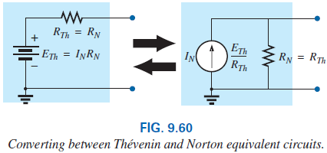
9.4 Norton’s Theorem
The Norton and Thévenin equivalent circuits can also be found from each other by using the source transformation discussed earlier in this chapter and reproduced in Fig. 9.60.

Slide 25
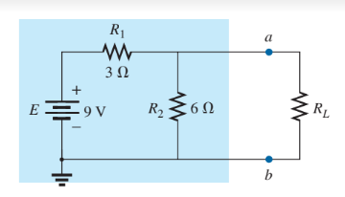
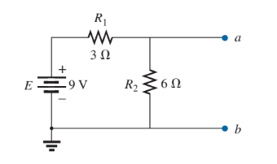
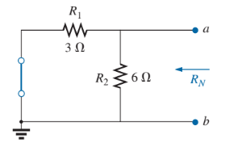
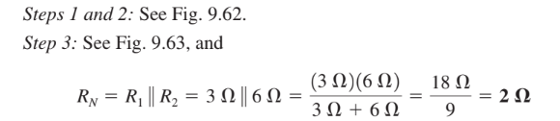
Calculating R_{N}:

Slide 26
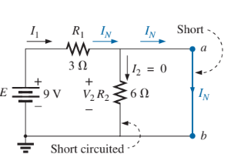
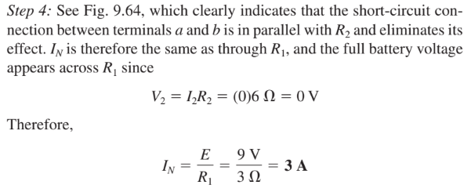
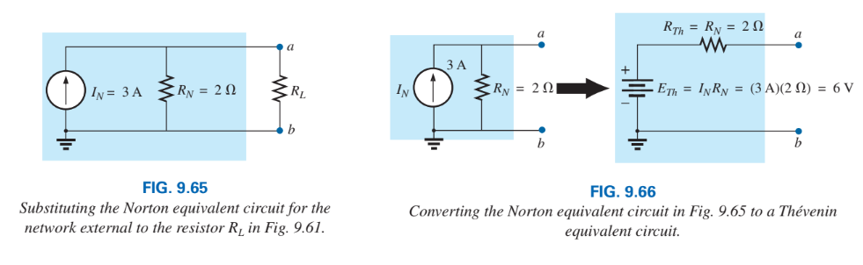
Calculating I_{N}:

Slide 27
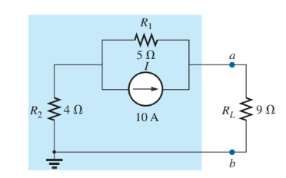
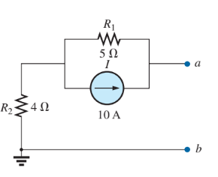
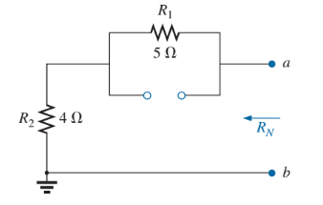

Calculating R_{N}:

Slide 28
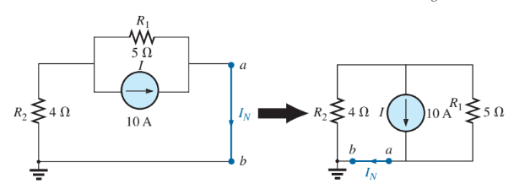
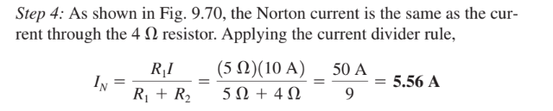
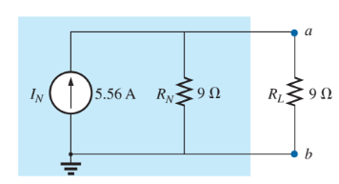
Calculating I_{N}:

Slide 29
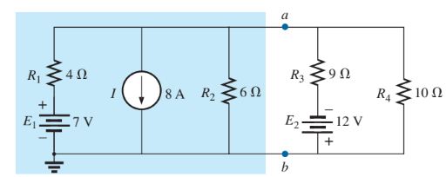


Calculating R_{N}:

Slide 30





Calculating I_{N}:

Slide 31
Thank You

